Slide 1


COFFEE SALES
ANALYSIS

Slide 2
The main objective of this project is to analyze the sales of a Coffee Shop with the help of data insights which will help enhance the performance of the shop with the help of MS Excel

Slide 3
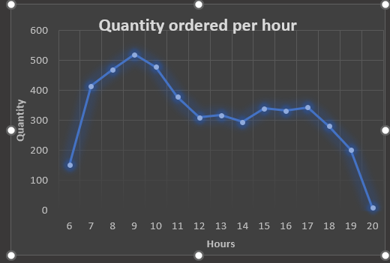
Here we are checking the peak hours, in which the finding is around 9 A.M

Slide 4
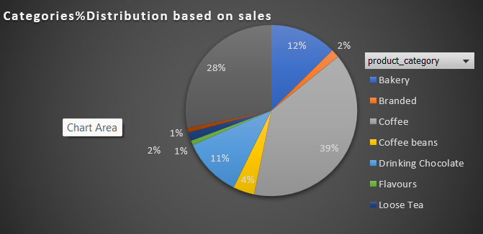
Now we are checking which Product category sold the most ,and the answer is Coffee

Slide 5
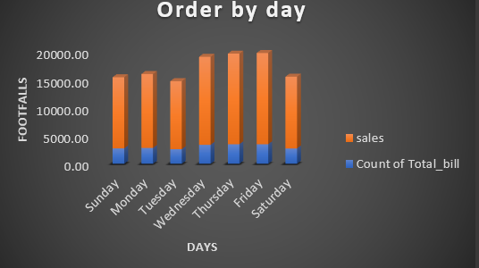
Here we are checking the order by day based on the footfalls in which found Friday just followed by Thursday has the most footfalls

Slide 6
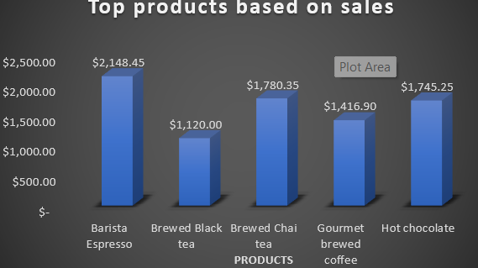
Now checking top products based on sales in which Barista Expresso tops the chart

Slide 7
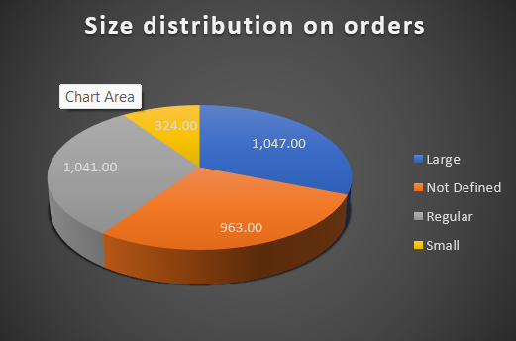
Size distribution on orders in which Large has the largest share

Slide 8
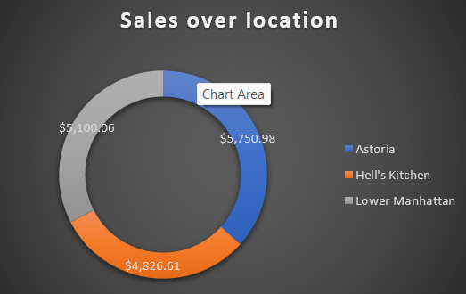
Talking about Sales over the location, Astoria has got the highest sales

